Slide 1
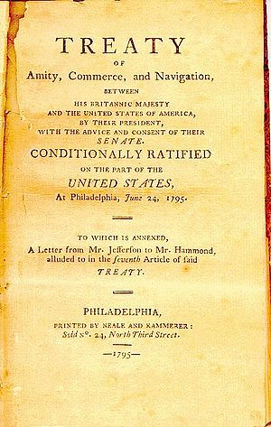
Jay’s Treaty: A Disliked Treaty that Continued Neutrality
1794

Slide 2
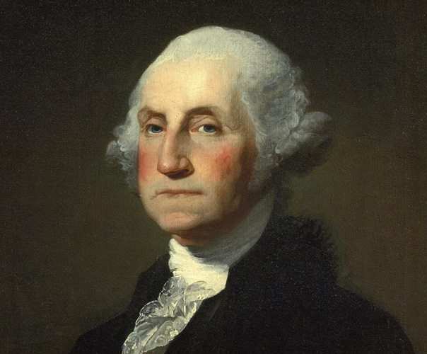
George Washington
His main goal was to remain neutral between Britain and France.

Slide 3
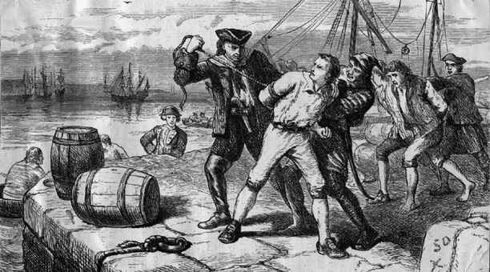
After the Revolution
Britain refused to evacuate their forts in the Northwest Territory
British continued to supply Native Americans with weapons
They took American Sailors from their ships and forced them to serve in the British navy

Slide 4
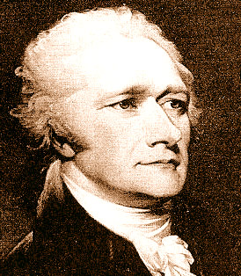
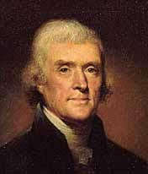
Views of the Political Parties
Federalists
Republicans
Did not want to go to war with Britain
Their view was supported by Alexander Hamilton
Wanted to go to war with Britain
Their view was supported by Thomas Jefferson

Slide 5
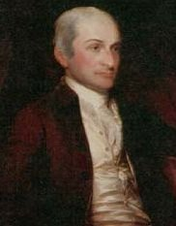
John Jay
Chief Justice of the Supreme Court
Was chosen by George Washington to negotiate a treaty with Britain

Slide 6
Jay’s Treaty
Britain had to..
U.S. had to..
Remove their soldiers located in the Northwest Territory
Stop supplying Native Americans with Weapons
Pay for all the damages that occurred in the impressments
Pay Britain for the debts they owed them leftover from the Revolutionary War

Slide 7
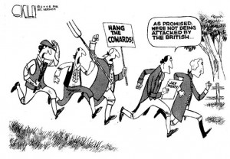
The Results of the Treaty
Many Americans were angry because they treaty did not stop British impressments on American sailors

Slide 8
Senate Passes the Treaty
The vote from the senate passed the treaty by a vote of 20 to 10
This was the minimum amount of votes to be passed

Slide 9
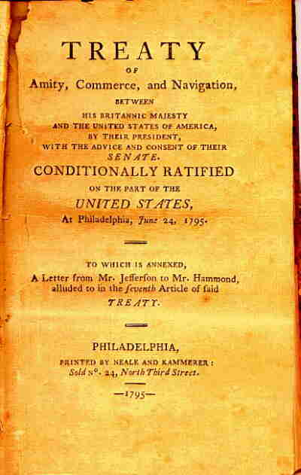
Overview
Although many people were disappointed in Jay’s Treaty, it prevented war from occurring with British.
It also kept Washington’s main goal of remaining neutral in foreign affairs.

